Slide 1


Scalable array data management with SciDB
EGU 2017, Short Course 54
April XXX, 2017 Marius Appel marius.appel@uni-muenster.de

Slide 2
EGU 2017 – SC 54 Topics
Part I: Analysing geoscientific arrays: Overview of data and software
Part II: Scalable data management and analysis with SciDB
Part III: Hands-on with SciDB and R
Change detection
Empirical Orthogonal Function analysis

Slide 3


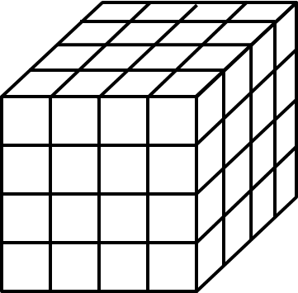
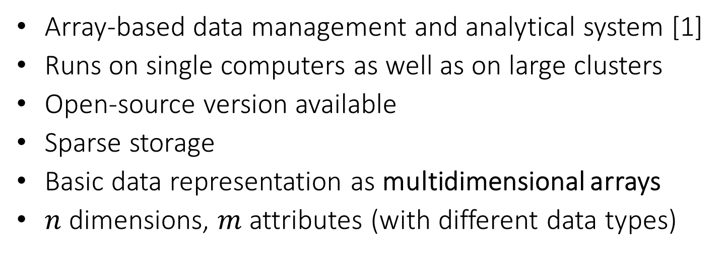
SciDB for large EO datasets
Array-based data management and analytical system [1]
Runs on single computers as well as on large clusters
Open-source version available
Sparse storage
Basic data representation as multidimensional arrays
$n$ dimensions, $m$ attributes (with different data types)
time
latitude
time
latitude
longitude
longitude
[1] Stonebraker, M., Brown, P., Zhang, D., & Becla, J. (2013). SciDB: A database management system for applications with complex analytics. Computing in Science & Engineering, 15(3), 54-62.

Slide 4
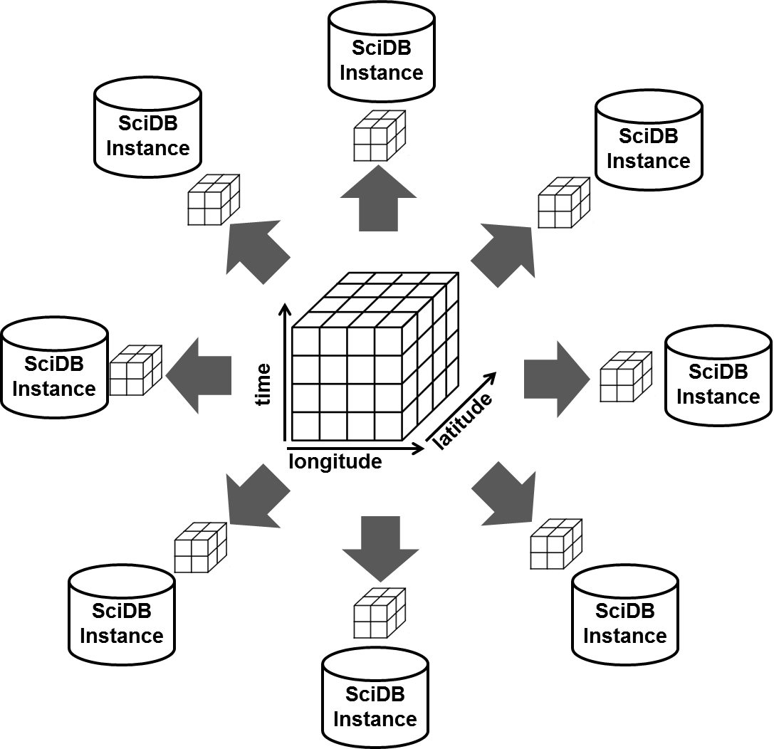
Distributing arrays by chunking
arrays are divided into equally sized chunks
chunks are distributed over many SciDB instances
instances may run on the same or different machines in a shared nothing cluster
distributing storage and computational load

Slide 5
Query language and functionality
SciDB query language: Array Functional Language (AFL)
Native functionality:
Load / write arrays from / to files
Arithmetic operations
subsetting by dimensions and or attributes
Aggregations (window, aggregate)
Array joins
Changing array schemas (repartitioning, redimensioning)
Linear algebra routines: (GEMM, GESVD, basic statistics)
…

Slide 6
SciDB: extensions for EO data
SciDB
can load data from CSV and custom-binary files only
does not understand spatial / temporal reference of arrays
spacetime extensions [1]:
scidb4geo (https://github.com/appelmar/scidb4geo)
scidb4gdal (https://github.com/appelmar/scidb4gdal)
[1] Appel M., Lahn F., Pebesma E., Buytaert W., Moulds S. (2016). Scalable Earth-observation Analytics for Geoscientists: Spacetime Extensions to the Array Database SciDB. accepted for poster presentation at EGU General Assembly 2016, Vienna, Austria April 17-22, 2016.
Notes:
Appel M., Lahn F., Pebesma E., Buytaert W., Moulds S. (2016). Scalable Earth-observation Analytics for Geoscientists: Spacetime Extensions to the Array Database SciDB. accepted for poster presentation at EGU General Assembly 2016, Vienna, Austria April 17-22, 2016.

Slide 7
scidb4geo
New AFL (Array Functional Language) operators
Operator | Description
eo_arrays() | Lists geographically referenced arrays
eo_setsrs() | Sets the spatial reference of existing arrays
eo_getsrs() | Gets the spatial reference of existing arrays
eo_extent() | Computes the geographic extent of referenced arrays
eo_settrs() | Sets the temporal reference of arrays
eo_gettrs() | Gets the temporal reference of arrays
eo_setmd() | Sets key value metadata of arrays and array attributes
eo_getmd() | Gets key value metadata of arrays and array attributes
eo_over() | Overlays two arrays by space and / or time

Slide 8
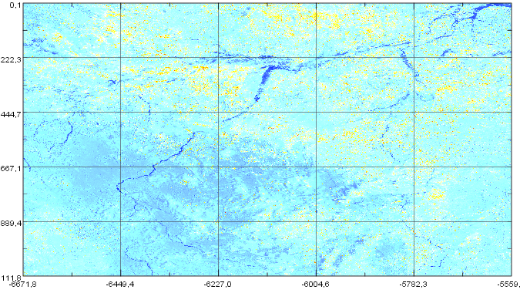
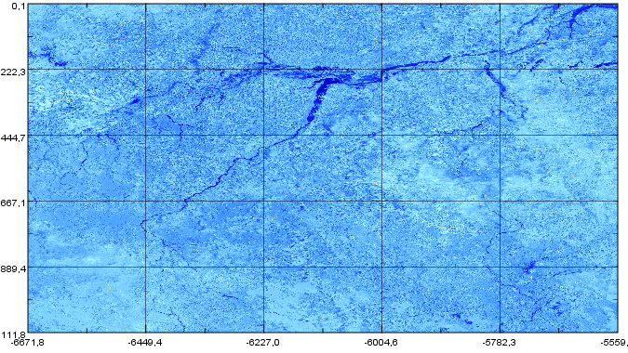
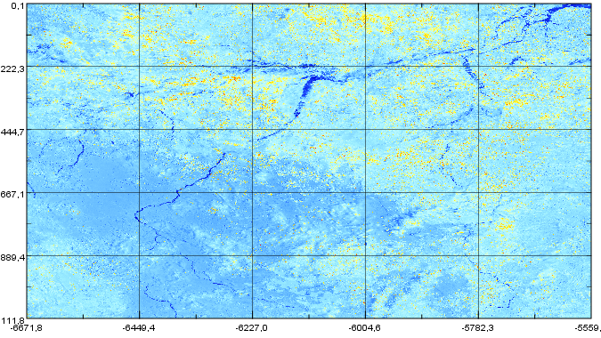
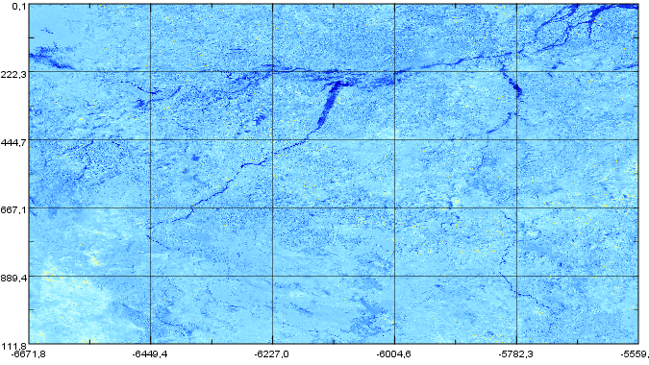
scidb4gdal
supports ingestion and download of images to and from SciDB
GDAL supports > 100 raster formats
ingestion automatically combines images by space and time (mosaicing)
t
lon
lat

Slide 9
Interfacing R
R as a client: packages scidb[1] and scidbst[2] works with proxy objects and lazy evaluation → starts computations when you want to read the data
overwrites R methods, e.g. %*%
limited to native SciDB functionality
Running R within SciDB: stream[3] and r_exec[4]
apply arbitrary R functions in parallel on chunks
[1] https://github.com/Paradigm4/SciDBR
[2] https://github.com/flahn/scidbst
[3] https://github.com/Paradigm4/stream
[4] https://github.com/Paradigm4/r_exec

Slide 10
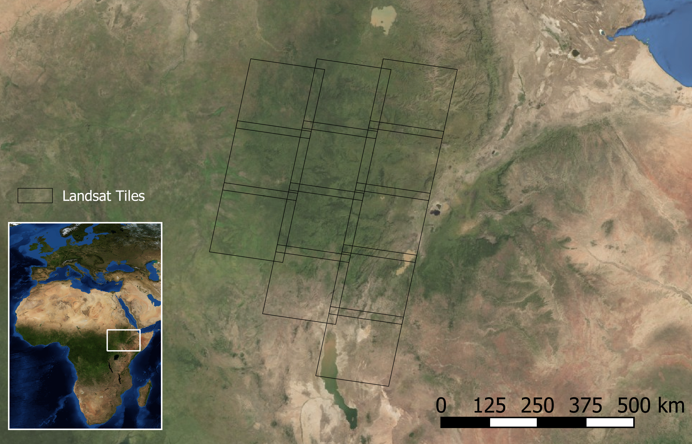
Study case: Landsat 7 in south west Ethiopia
Landsat 7 data from 12 tiles captured between 2003-07-21 and 2014-12-27 → 1975 scenes
Derived NDVI product from ESPA
approx. 325,000 km²
monitor changes starting with 2010-01-01, with ROC history model

Slide 11
Landsat 7 in SciDB
Ingestion:
For all *_ndvi.tif images:
extract date from filename
reproject / warp to the same spatial reference system
upload to SciDB
Repartition the array such that chunks contain complete time series of 64x64 pixels
Preprocessing:
remove any values <= -9999 or >10000
unscale to -1, 1

Slide 12
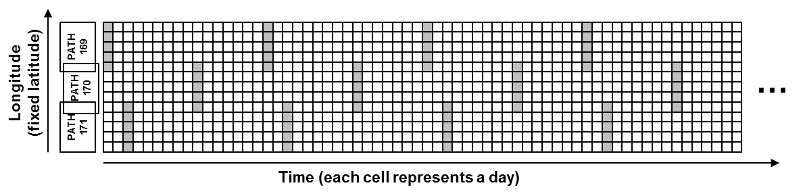

Landsat 7 in SciDB
The data is represented in SciDB as a three-dimensional array with daily temporal resolution and
49548 x 47713 x 4177 cells in total
64, 64, 4177 cells per chunk
Only 0.5% ($54⋅{10}^{9}$) of the cells contain data
SciDB has sparse storage

Slide 13
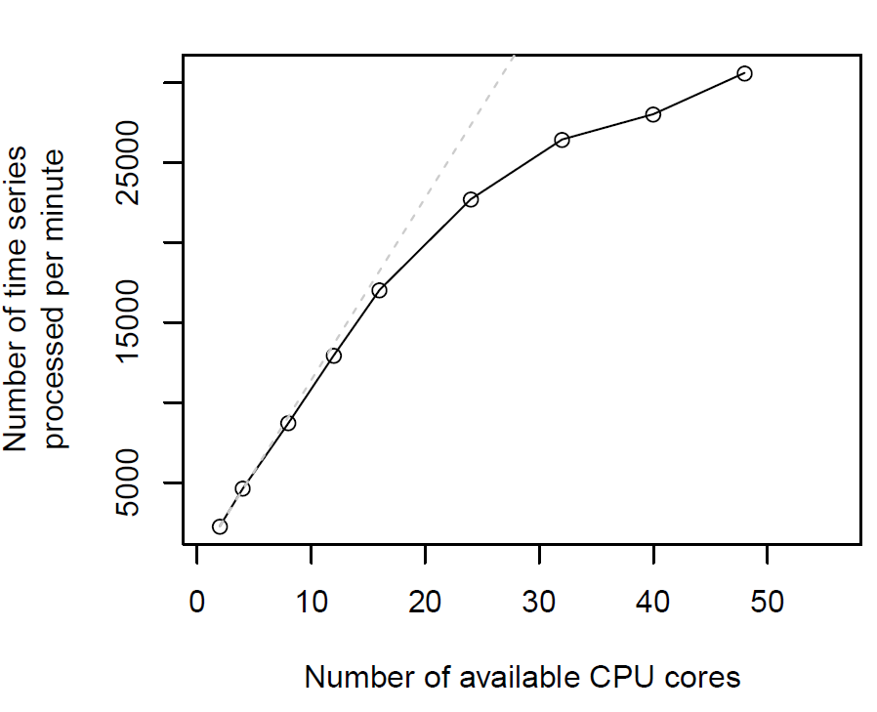
Scalability with SciDB instances
16 SciDB instances on one machine used (64 CPU cores, 256 GB main memory)
running bfast monitor repeatedly with different number of available CPU cores on a small subset

Slide 14
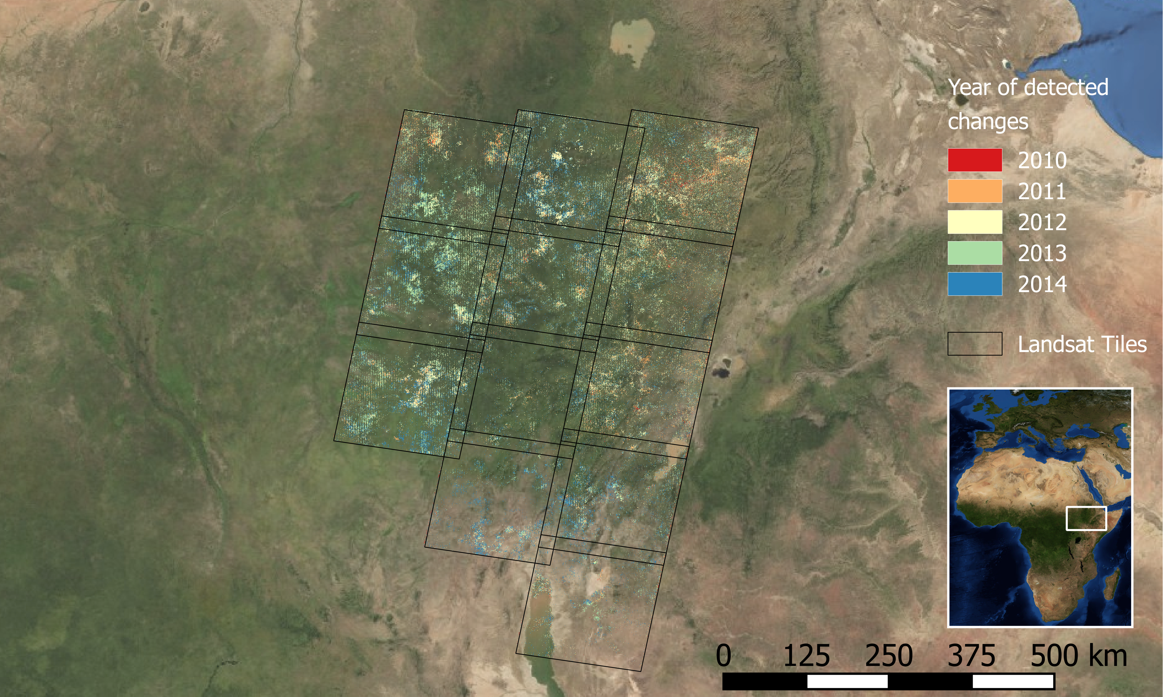
Study case: results
Notes:
2 GB → QGIS

Slide 15
Conclusions
SciDB is able to scale even in large cluster environments
The multidimensional array model, chunking, and sparse storage are well-suited to represent large EO datasets from many scenes
Ingestion and data restructuring time consuming
Installation and data ingestion not straightforward
Analysis from R easy to learn for R users

Slide 16
Thank you
Questions?

